Slide 1
MAY 2025
Reinforcement learning (RL) for adaptive control of an unmanned surface vehicle (USV)
Justin Hart
Master’s Student, The University of Texas at Austin

Slide 2
Background
USVs are used in various industries including defense, oil and gas, oceanographic research, and energy
Course keeping is a key control task in the overall automation of USVs
RL could allow for the development of a course keeping controller that is robust to varying disturbances and conditions

Slide 3
Objective
Implement a USV course keeping controller that uses RL combined with PID control as described in this paper [1]
Use a dual propeller controlled USV model – the paper uses rudder control

Slide 4
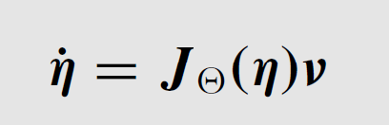
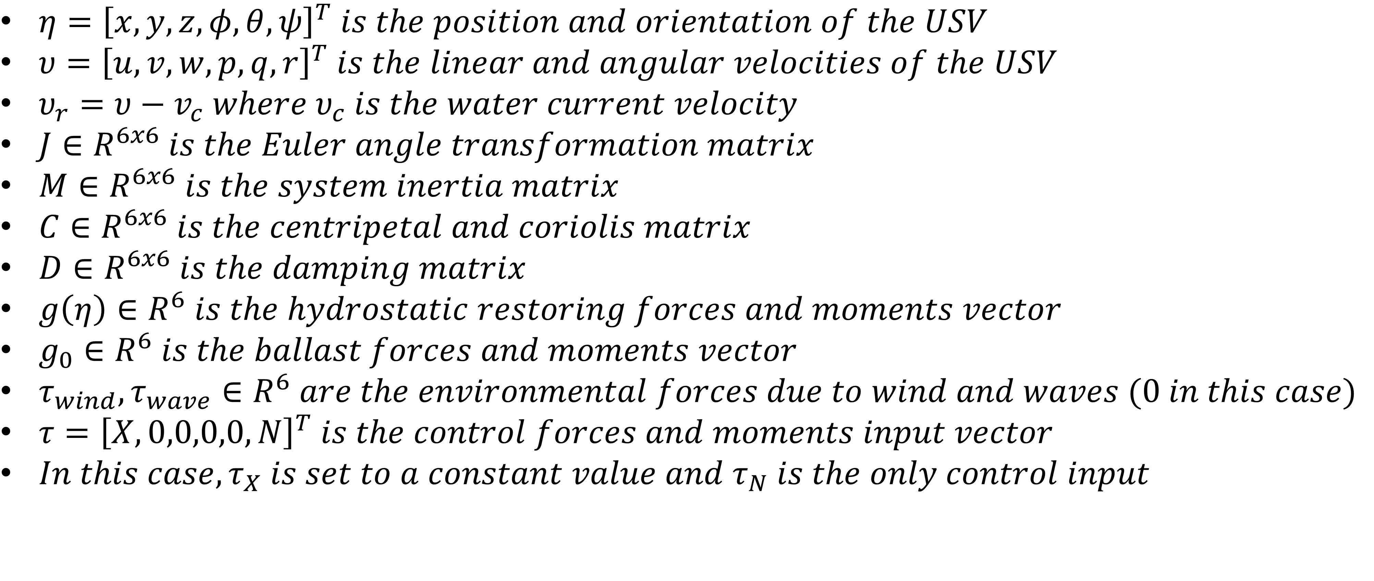
USV Model [2]
$η={\left[x,y,z,φ,θ,ψ\right]}^{T} is the position and orientation of the USV$
$υ={\left[u,v,w,p,q,r\right]}^{T} is the linear and angular velocities of the USV$
$υ_{r}=υ−v_{c} where υ_{c} is the water current velocity$
$J∈R^{6x6} is the Euler angle transformation matrix$
$M∈R^{6x6} is the system inertia matrix$
$C∈R^{6x6} is the centripetal and coriolis matrix$
$D∈R^{6x6} is the damping matrix$
$g\left(η\right)∈R^{6} is the hydrostatic restoring forces and moments vector$
$g_{0}∈R^{6} is the ballast forces and moments vector$
$τ_{wind},τ_{wave}∈R^{6} are the environmental forces due to wind and waves (0 in this case)$
$τ={\left[X,0,0,0,0,N\right]}^{T} is the control forces and moments input vector$
$In this case, τ_{X} is set to a constant value and τ_{N} is the only control input$

Slide 5
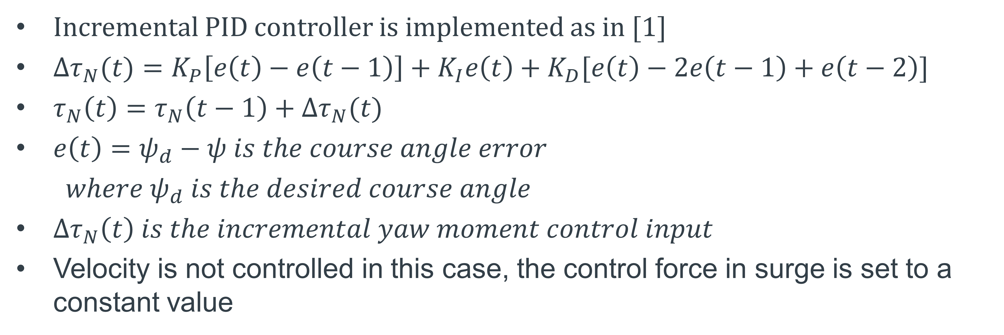
Course Keeping Control [1]
Incremental PID controller is implemented as in [1]
$Δτ_{N}(t)=K_{P}\left[e\left(t\right)−e\left(t−1\right)\right]+K_{I}e\left(t\right)+K_{D}[e\left(t\right)−2e\left(t−1\right)+e\left(t−2\right)]$
$τ_{N}\left(t\right)=τ_{N}\left(t−1\right)+Δτ_{N}(t)$
$e\left(t\right)=ψ_{d}−ψ is the course angle error$
$where ψ_{d} is the desired course angle$
$Δτ_{N}\left(t\right) is the incremental yaw moment control input$
Velocity is not controlled in this case, the control force in surge is set to a constant value

Slide 6
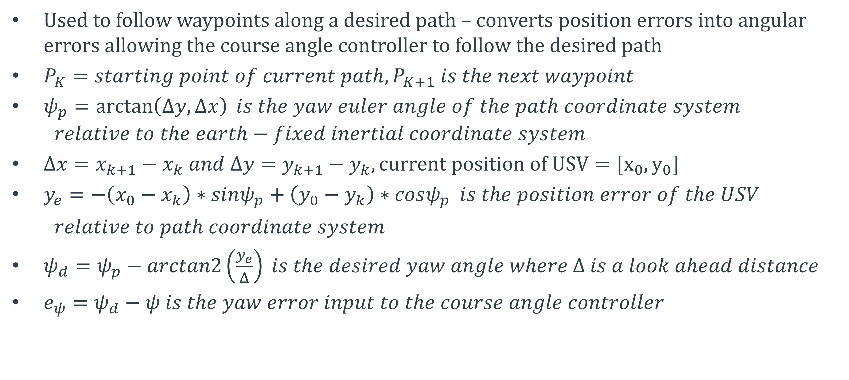
Line of Sight (LOS) Guidance Law [1],[2]
Used to follow waypoints along a desired path – converts position errors into angular errors allowing the course angle controller to follow the desired path
$P_{K}=starting point of current path, P_{K+1} is the next waypoint$
$ψ_{p}=\arctan\left(Δy,Δx\right) is the yaw euler angle of the path coordinate system$
$$relative to the earth−fixed inertial coordinate system$$
$Δx=x_{k+1}−x_{k} and Δy=y_{k+1}−y_{k}, current position of USV=[x_{0},y_{0}]$
$y_{e}=−\left(x_{0}−x_{k}\right)∗sinψ_{p}+\left(y_{0}−y_{k}\right)∗cosψ_{p} is the position error of the USV$
$relative to path coordinate system$
$ψ_{d}=ψ_{p}−arctan2\left(\frac{y_{e}}{Δ}\right) is the desired yaw angle where Δ is a look ahead distance$
$e_{ψ}=ψ_{d}−ψ is the yaw error input to the course angle controller$

Slide 7
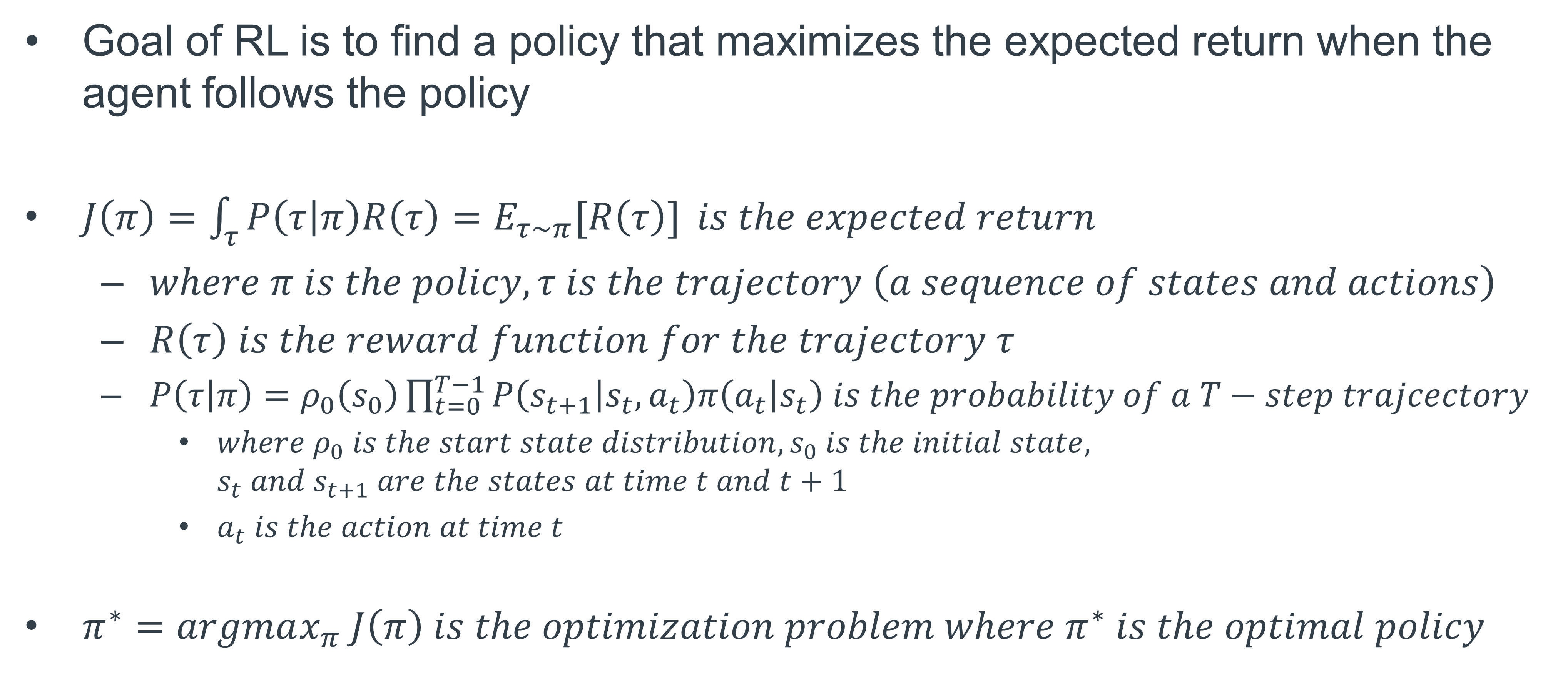
Reinforcement Learning [3]
Goal of RL is to find a policy that maximizes the expected return when the agent follows the policy
$J\left(π\right)=\int_{τ}^{ }{P\left(τ | π\right)R\left(τ\right)=E_{τ\sim π}[R\left(τ\right)]} is the expected return$
$where π is the policy, τ is the trajectory \left(a sequence of states and actions\right)$
$R\left(τ\right) is the reward function for the trajectory τ$
$P\left(τ | π\right)=ρ_{0}\left(s_{0}\right)\prod_{t=0}^{T−1}{P\left(s_{t+1} | s_{t},a_{t}\right)π\left(a_{t} | s_{t}\right) is the probability of a T−step trajcectory}$
$where ρ_{0} is the start state distribution, s_{0} is the initial state, s_{t} and s_{t+1} are the states at time t and t+1$
$a_{t} is the action at time t$
$π^{∗}=argmax_{π} J\left(π\right) is the optimization problem where π^{∗} is the optimal policy$

Slide 8
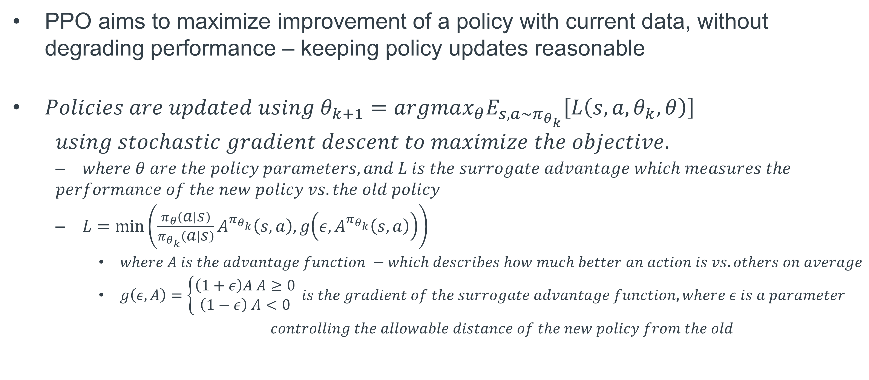
Proximal Policy Optimization (PPO) [3],[4]
PPO aims to maximize improvement of a policy with current data, without degrading performance – keeping policy updates reasonable
$Policies are updated using θ_{k+1}=argmax_{θ}E_{s,a\sim π_{θ_{k}}}\left[L\left(s,a,θ_{k},θ\right)\right]$
$using stochastic gradient descent to maximize the objective.$
$where θ are the policy parameters, and L is the surrogate advantage which measures the$
$$performance of the new policy vs. the old policy$$
$L=\min\left(\frac{π_{θ}\left(a | s\right)}{π_{θ_{k}}\left(a | s\right)}A^{π_{θ_{k}}}\left(s,a\right), g\left(ε,A^{π_{θ_{k}}}\left(s,a\right)\right)\right)$
$where A is the advantage function −which describes how much better an action is vs. others on average$
$g\left(ε,A\right)=\left\{\begin{aligned}\left(1+ε\right)A A≥0 \\ \left(1−ε\right) A<0\end{aligned}\right. is the gradient of the surrogate advantage function, where ε is a parameter$
$controlling the allowable distance of the new policy from the old$

Slide 9
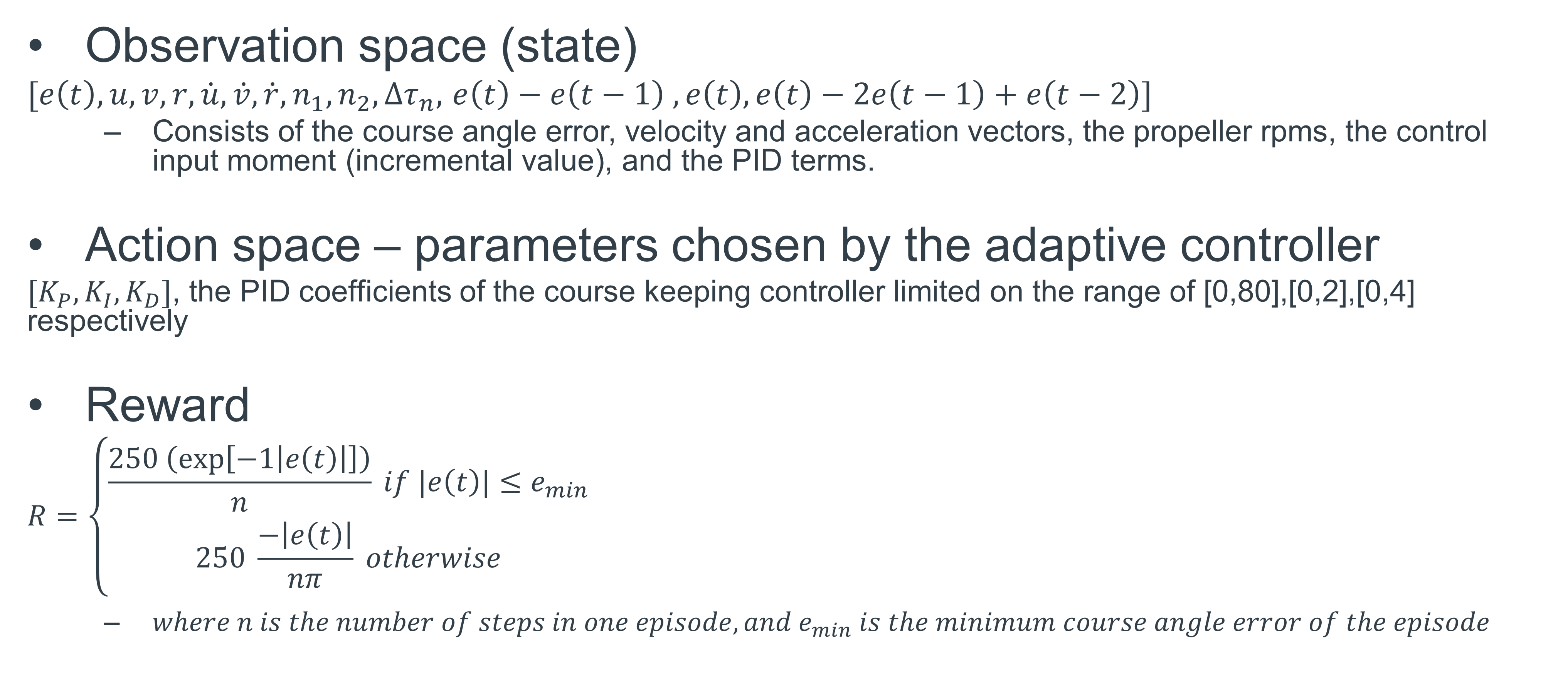
RL Setup
Observation space (state)
$[e\left(t\right),u,v,r,\dot{u},\dot{v},\dot{r},n_{1},n_{2},Δτ_{n},$ $e\left(t\right)−e\left(t−1\right) ,e\left(t\right), e\left(t\right)−2e\left(t−1\right)+e\left(t−2\right)]$
Consists of the course angle error, velocity and acceleration vectors, the propeller rpms, the control input moment (incremental value), and the PID terms.
Action space – parameters chosen by the adaptive controller
$[K_{P},K_{I},K_{D}]$, the PID coefficients of the course keeping controller limited on the range of [0,80],[0,2],[0,4] respectively
Reward
$$R=\left\{\begin{aligned}\frac{250 \left(\exp\left[−1\left|e\left(t\right)\right|\right]\right)}{n} if |e\left(t\right)|≤e_{min} \\ 250 \frac{−\left|e\left(t\right)\right|}{nπ} otherwise\end{aligned} \right.$$
$where n is the number of steps in one episode, and e_{min} is the minimum course angle error of the episode$

Slide 10
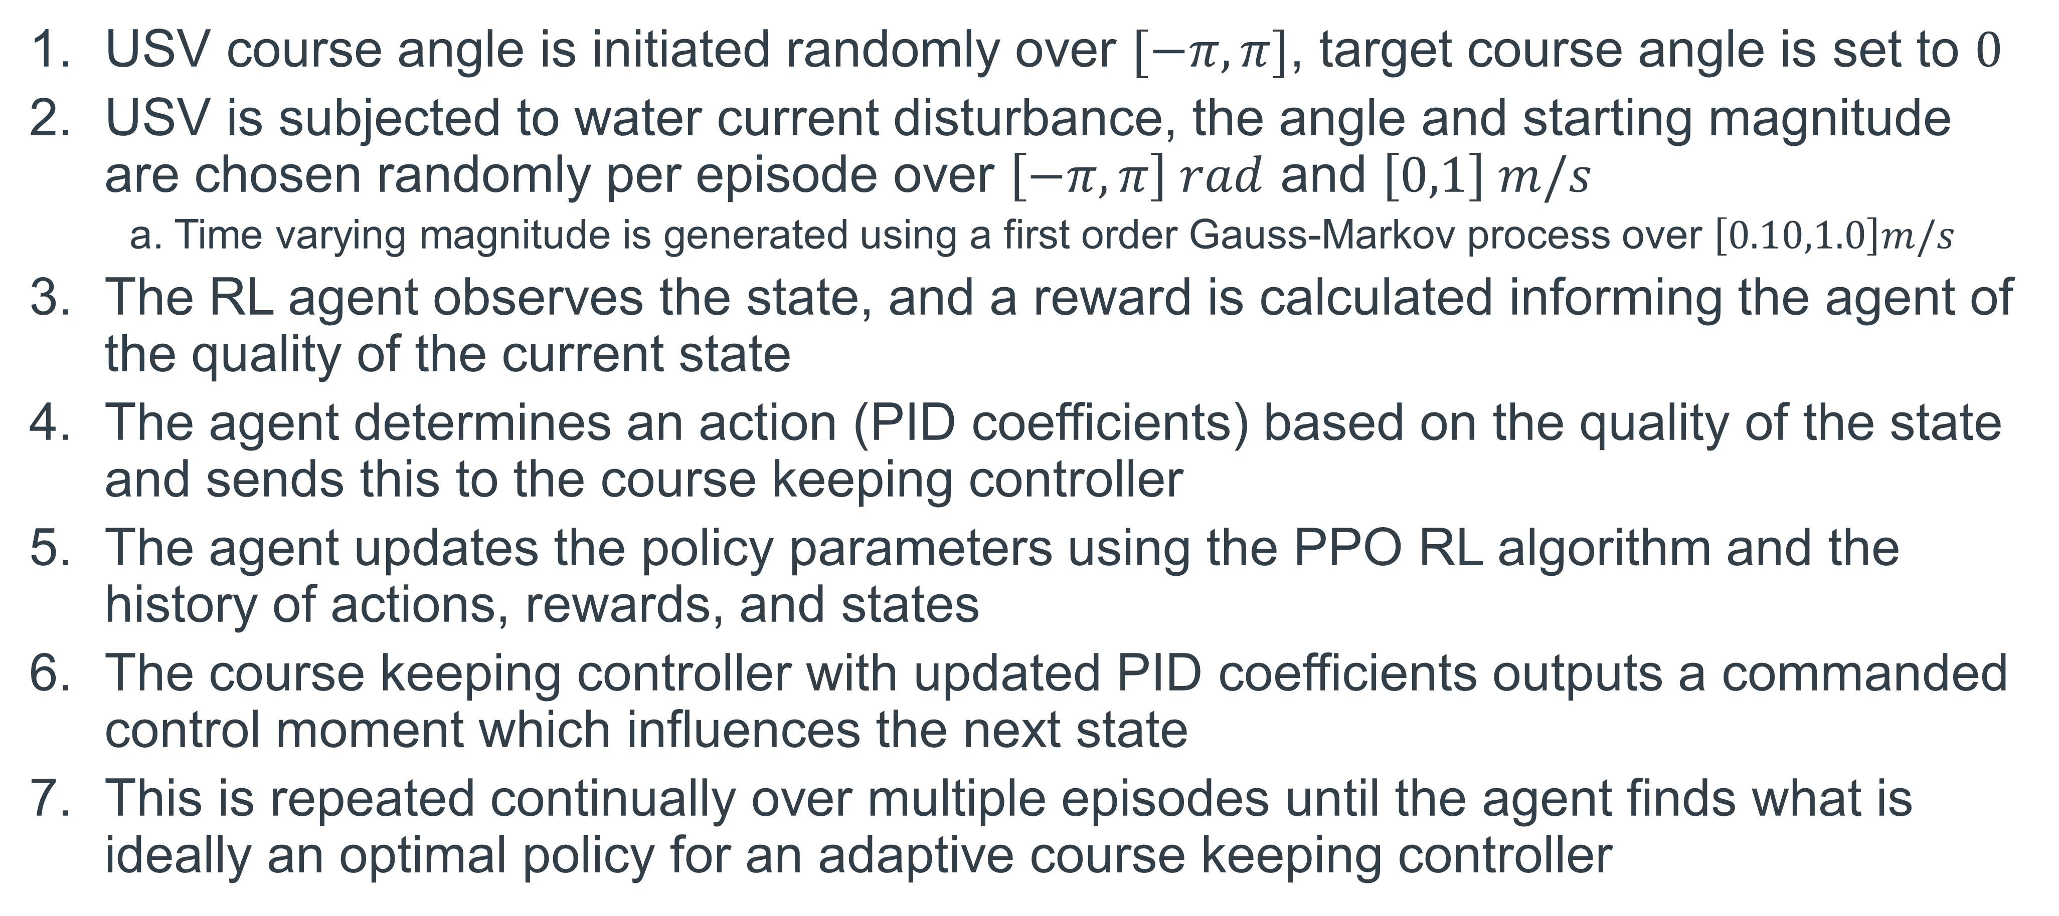
Training Setup
USV course angle is initiated randomly over $[−π,π]$, target course angle is set to $0$
USV is subjected to water current disturbance, the angle and starting magnitude are chosen randomly per episode over $\left[−π,π\right] rad$ and $\left[0,1\right] m/s$
a. Time varying magnitude is generated using a first order Gauss-Markov process over $\left[0.10,1.0\right]m/s$
The RL agent observes the state, and a reward is calculated informing the agent of the quality of the current state
The agent determines an action (PID coefficients) based on the quality of the state and sends this to the course keeping controller
The agent updates the policy parameters using the PPO RL algorithm and the history of actions, rewards, and states
The course keeping controller with updated PID coefficients outputs a commanded control moment which influences the next state
This is repeated continually over multiple episodes until the agent finds what is ideally an optimal policy for an adaptive course keeping controller

Slide 11
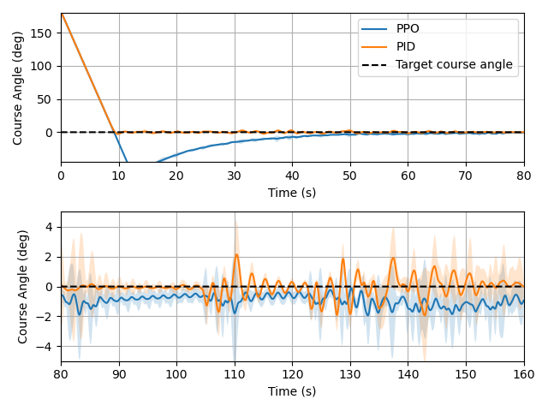
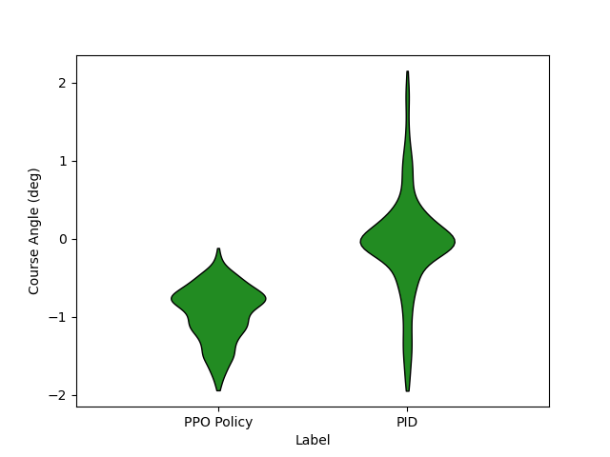
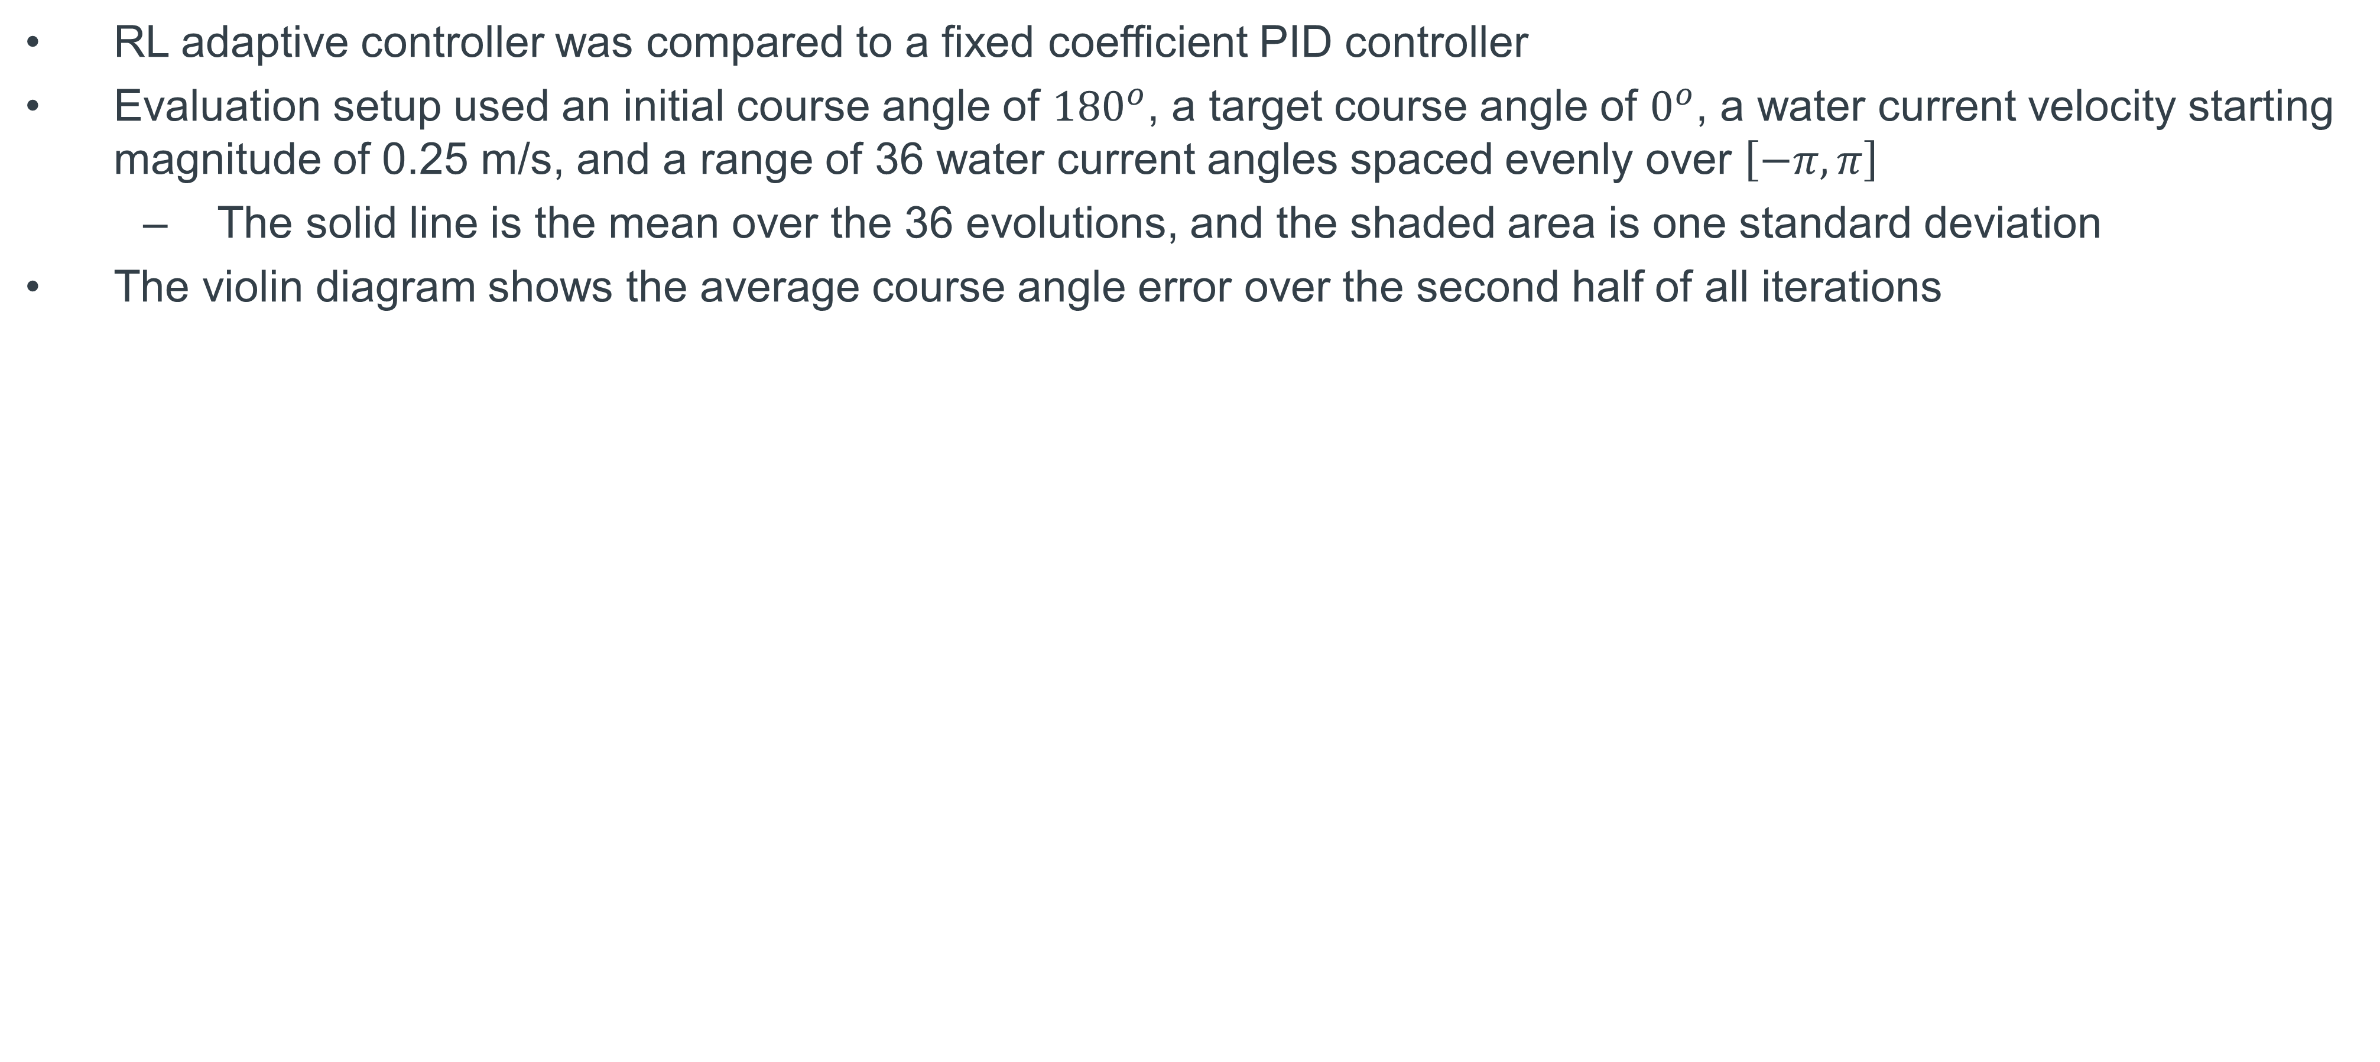
Results – Course Keeping
RL adaptive controller was compared to a fixed coefficient PID controller
Evaluation setup used an initial course angle of ${180}^{o}$, a target course angle of $0^{o}$, a water current velocity starting magnitude of 0.25 m/s, and a range of 36 water current angles spaced evenly over $\left[−π,π\right]$
The solid line is the mean over the 36 evolutions, and the shaded area is one standard deviation
The violin diagram shows the average course angle error over the second half of all iterations

Slide 12
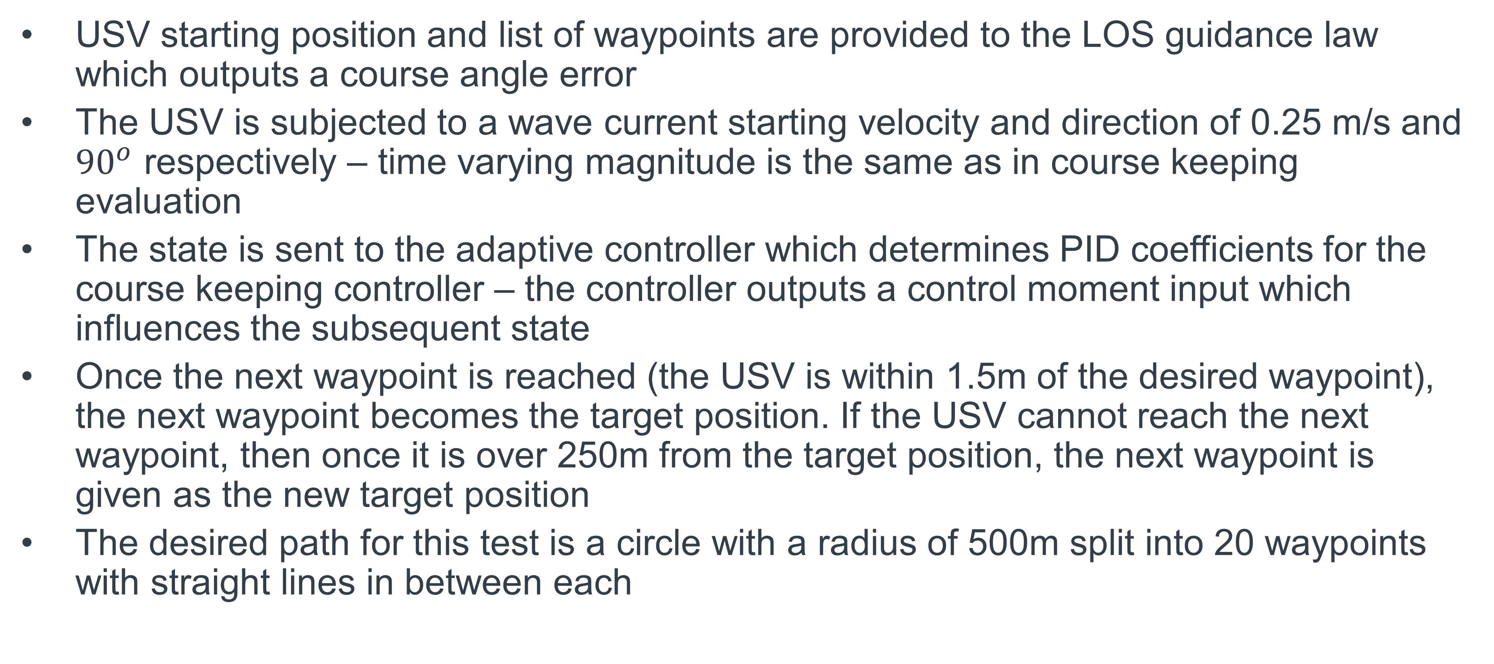
Results – Path Following
USV starting position and list of waypoints are provided to the LOS guidance law which outputs a course angle error
The USV is subjected to a wave current starting velocity and direction of 0.25 m/s and ${90}^{o}$ respectively – time varying magnitude is the same as in course keeping evaluation
The state is sent to the adaptive controller which determines PID coefficients for the course keeping controller – the controller outputs a control moment input which influences the subsequent state
Once the next waypoint is reached (the USV is within 1.5m of the desired waypoint), the next waypoint becomes the target position. If the USV cannot reach the next waypoint, then once it is over 250m from the target position, the next waypoint is given as the new target position
The desired path for this test is a circle with a radius of 500m split into 20 waypoints with straight lines in between each

Slide 13
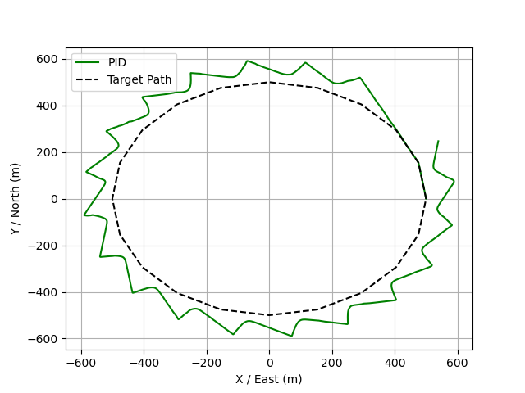
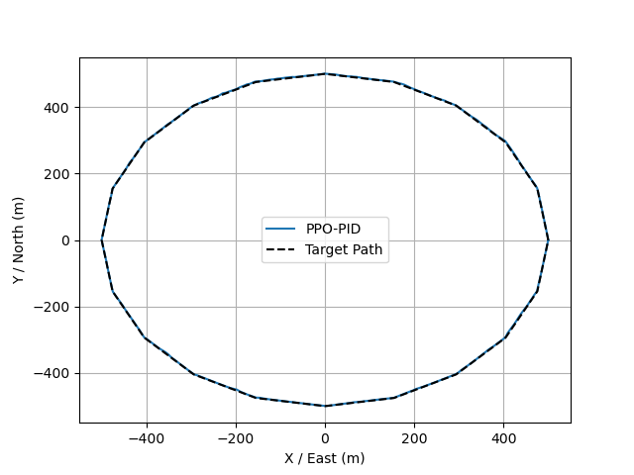
Results – Path Following

Slide 14
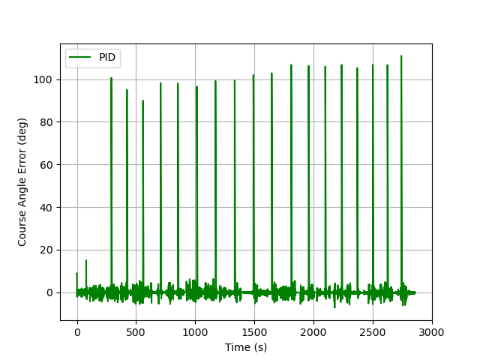
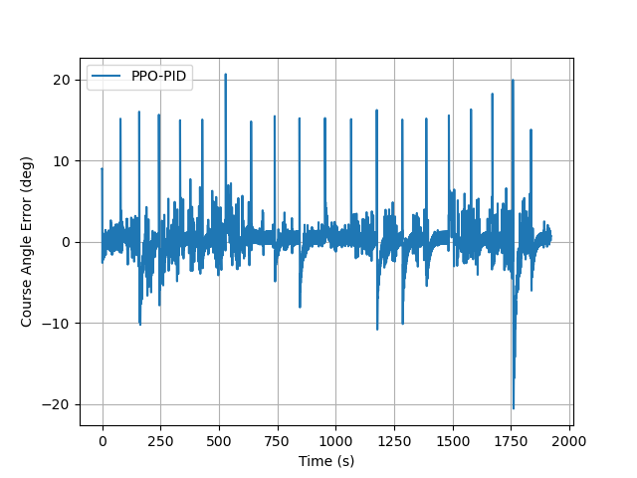
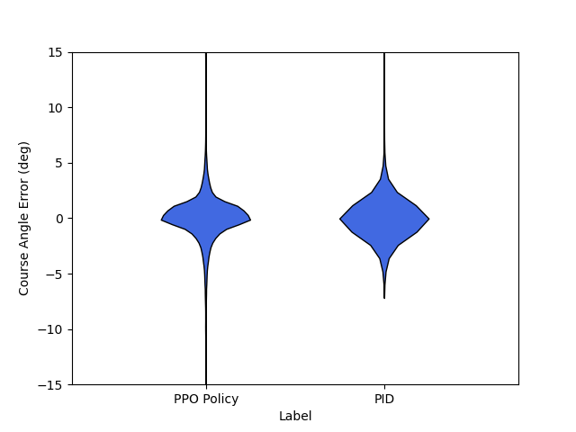
Results – Path Following

Slide 15
Conclusions
RL was combined with PID control to develop an adaptive trajectory tracking controller for a dual propeller driven USV.
The PPO-PID controller displayed a much slower settling time and a relatively large overshoot in the course keeping evaluation (which was set to the maximum course angle error), but showed less oscillation once reaching the setpoint
The PPO-PID controller performed better in the path following evaluation when faced with a time-varying disturbance magnitude vs. the fixed PID controller.

Slide 16
Future Work
Implement more complex disturbance model to include wind and wave forces and moments
Explore trajectory control (path following with temporal constraints)
Implement other RL algorithms (SAC)
Integrate on actual hardware

Slide 17
References
[1] Lai, P., Liu, Y., Zhang, W., & Xu, H. (2023). Intelligent controller for unmanned surface vehicles by deep reinforcement learning. Physics of Fluids, 35(3).
[2] Fossen, T. I. (2011). Handbook of marine craft hydrodynamics and motion control. John Willy & Sons Ltd.
[3] Achiam, J. (2018). Spinning Up in Deep Reinforcement Learning.
[4] Schulman, J., Wolski, F., Dhariwal, P., Radford, A., & Klimov, O. (2017). Proximal policy optimization algorithms. arXiv preprint arXiv:1707.06347.
[5] Fossen, T. I. (2020). Python vehicle simulator. Github Repository.

